Slide 1
China Biographical Database Project (CBDB)
T’ang Studies Society Workshop on the China Biographical Database Harvard University August 22-23, 2013 Sponsored by the T’ang Studies Society
Notes:
1

Slide 2
China Biographical Database Project (CBDB)
Session Three:
The Design of Research Projects using Relational Database Entities and CBDB
Michael A. Fuller
Notes:
2

Slide 3
China Biographical Database Project (CBDB)
In your projects, you primarily will need to think about the design of the specific “thing” you want to link to CBDB and explore.
For example, I have created a small sample database that can be used to record information on texts in a 文集.
Let’s download and open it.
Notes:
3

Slide 4
China Biographical Database Project (CBDB)
The workhorse (“PeopleInTexts”) table captures “People in Texts” and has the following fields:
Author
PersonInText
TextTitle
TextType
TextYear
TextSource
SourcePage
CitationNotes
Text (255)
Text (255)
Text (255)
Text (255)
Number (Integer)
Text (255)
Text (255)
Memo
Notes:
4

Slide 5
China Biographical Database Project (CBDB)
And we have some initial data:
Author | PersonIn Text | Person Role | TextTitle | TextType | Text Year | TextSource | SourcePage | CitationNotes
權德輿 | 劉昌 | Subject | 大唐四鎮北庭行軍兼涇原等州節度度支營田等使開府儀同三司檢校尚書右僕射使持節涇州諸軍事涇州刺史兼御史大夫上柱國南川郡王劉公紀功碑銘 | 碑銘 |  | 權德輿詩文集 | 1.12.189-93
權德輿 | 張孝忠 | Subject | 唐故義武軍節度使營田易定等州觀察處置使開府儀同三司檢校司空同中書門下平章事范陽郡王贈太師貞武張公遺愛碑銘 | 碑銘 |  | 權德輿詩文集 | 1.11.183-88
權德輿 | 杜亚 | Recipient | 與睦州杜給事書 | 書 |  | 權德輿詩文集 | 2.42.637-38 | 建中二年十二月九日
權德輿 | 杜佑 | Subject | 大唐銀青光祿大夫檢校司徒同中書門下平章事太清宮及度支諸道鹽鐵轉運等使崇文館大學士上柱國岐國公杜公淮南遺愛碑銘 | 碑銘 |  | 權德輿詩文集 | 1.11.178-82
權德輿 | 杜佑 | Subject | 祭故杜岐公文 | 祭文 |  | 權德輿詩文集 | 2.49.777-78
權德輿 | 馬燧 | Subject | 故司徒兼侍中上柱國北平郡王贈太傅馬公行狀 | 行狀 |  | 權德輿詩文集 | 1.19.296-307
Notes:
5

Slide 6
China Biographical Database Project (CBDB)
Having collected data, one needs to integrate it with CBDB data in order to avoid repeating effort.
The best way to do it, at least initially, is to copy CBDB tables into your database.
You will want:
People ZZZ_BIOG_MAIN
Entry Data ZZZ_ENTRY_DATA
Place Data ZZZ_BIOG_ADDR_DATA
Kinship Data ZZZ_KIN_BIOG_ADDR
Association Data ZZZ_NONKIN_BIOG_ADDR
Posting Data ZZZ_POSTED_TO_OFFICE_DATA
ZZZ_POSTED_TO_ADDR_DATA
Text Data (?) ZZZ_TEXT_DATA
Notes:
6

Slide 7
China Biographical Database Project (CBDB)
Also, add some code tables (for convenient look-up):
Address Hierarchy ZZZ_BELONGS_TO
Entry Codes ENTRY_CODES
ENTRY_TYPES
ENTRY_CODE_TYPE_REL
Association Codes ASSOC_CODES
ASSOC_TYPES
ASSOC_CODE_TYPE_REL
Place Association Codes BIOG_ADDR_CODES
Kinship Codes KINSHIP_CODES
Dynasties DYNASTIES
年號 NIAN_HAO
Office Codes OFFICE_CODES
OFFICE_TYPE_TREE
OFFICE_CODE_TYPE_REL
Notes:
7

Slide 8
China Biographical Database Project (CBDB)
Now that you have added the CBDB tables, you’ll need to link your table to them.
First, you’re going to need a list of all people in your table:
Open the Query Builder
Add your table
Select the “PersonInText” field
Run the query: note that you have duplicates.
Go into SQL View
add “distinct” after “SELECT”
add “as pname” after PersonInText in the SELECT list
Rerun the query
Change the query to a “Make Table” (table = PNames1)
Close and Save the query as “My People1 Query” Run
Notes:
8

Slide 9
China Biographical Database Project (CBDB)
Open the Query Builder again
Add your table
Select the “Author” field
Go into SQL View
add “distinct” after “SELECT”
add “as pname” after Author in the SELECT list
Change the query to a “Make Table” (table = PNames2)
Close and Save the query as “My People2 Query”
Run
Copy all the records from PNames2 into PName1
Open the Query Builder again
Add PName1
Select the “pname” field
Go into SQL View
add “distinct” after “SELECT”
Close and Save the query as “My People Query”
Notes:
9

Slide 10
China Biographical Database Project (CBDB)
Open the Query Builder again
Add ZZZ_BIOG_MAIN and “My People Query”
Drag the “pname” field to c_name_chn in ZZZ_BIOG_MAIN
Double-click on the link and select “All records in ‘My People Query’”
Add “PersonInText” and c_personid, c_index_year
Run the query
Change the query to a “Make Table” (table = PeopleID)
Close and save as PeopleID Query
Run the query
Open the new table PeopleID
Delete the irrelevant records
IF YOU NEED TO ADD PEOPLE TO ZZZ_BIOG_MAIN
oh well, you have to add them: give them numbers starting with
300000 and let us know, so we can add them and report their CBDB system IDs to you.
Notes:
10

Slide 11
China Biographical Database Project (CBDB)
Step Two (if you wish):
Normalize the data by breaking the PeopleInTexts table into five tables:
1. PeopleID (you just created)
2. TextID
3. RoleID
4. GenreID
5. PeopleTextData (swaps most of the text for codes)
Notes:
11

Slide 12
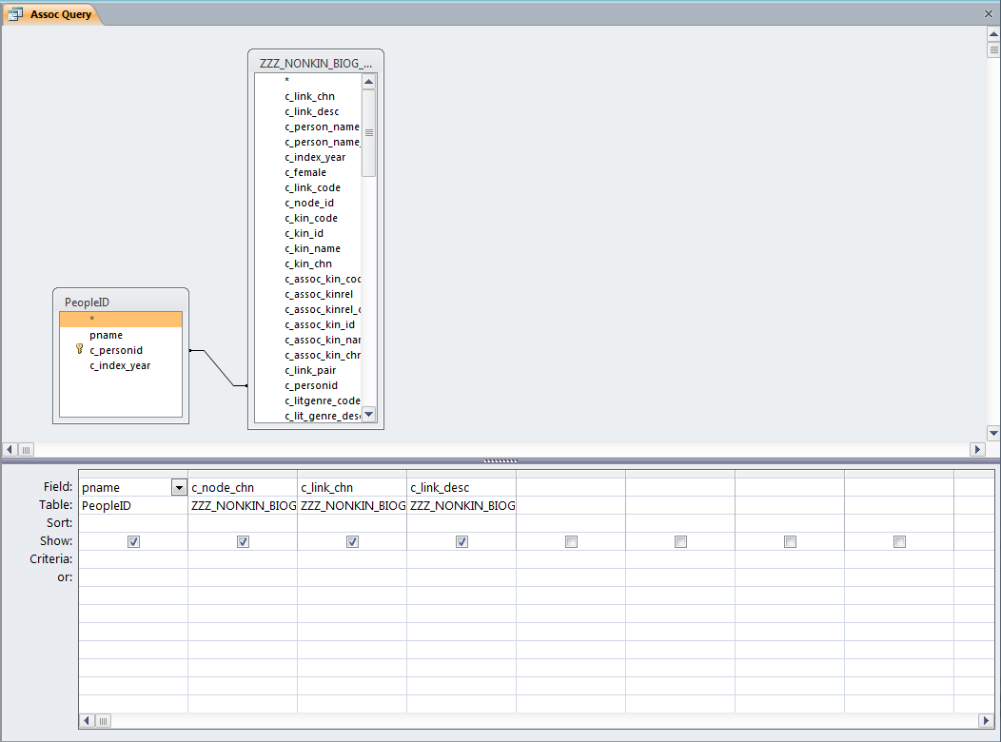
China Biographical Database Project (CBDB)
Once you have made the PeopleID table, you can see what data CBDB has on the people in your database. Please create this query:
Notes:
12

Slide 13
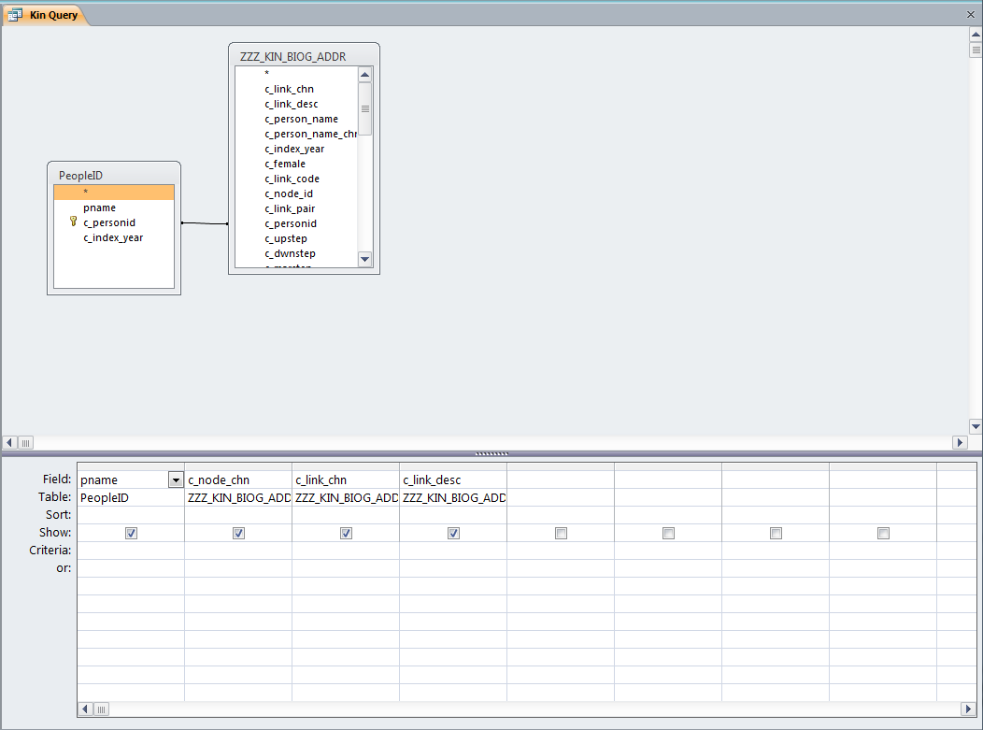
China Biographical Database Project (CBDB)
And this query:
Notes:
13

Slide 14
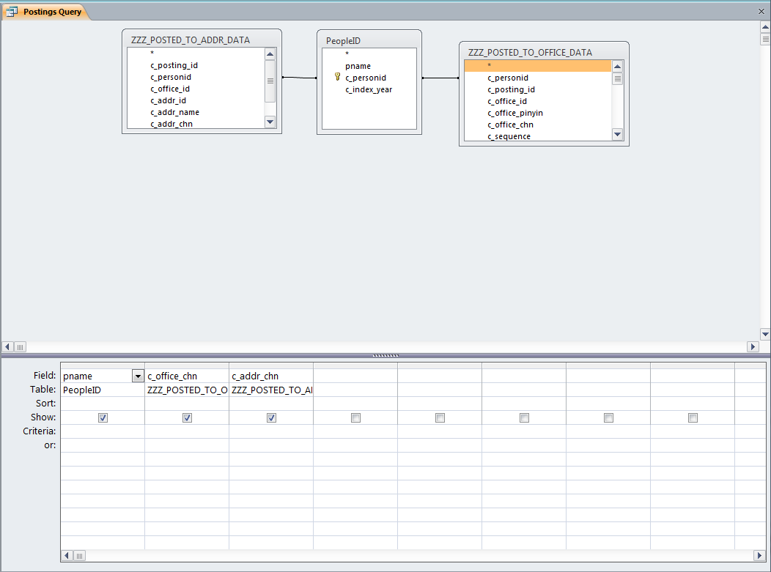
China Biographical Database Project (CBDB)
And this query:
Notes:
14

Slide 15
China Biographical Database Project (CBDB)
At this point, I’ll get out of your way and let you start to develop a model for your project. If you have questions, I’ll be circulating in the room.
Notes:
15

