Slide 1
NDSA NE - October 30, 2014
University of Massachusetts, Amherst Libraries

Slide 2
Overview & Updates
Andrea Goethals, Harvard Library

Slide 3
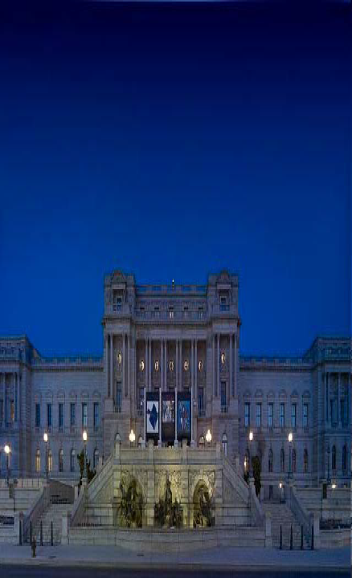
NDSR mission
... to develop the next generation of stewards to collect, manage, preserve, and make accessible our nation’s digital assets
... to provide residents with a combination of hands-on learning and expert guidance
... help define clear educational standards for digital stewardship education and training

Slide 4
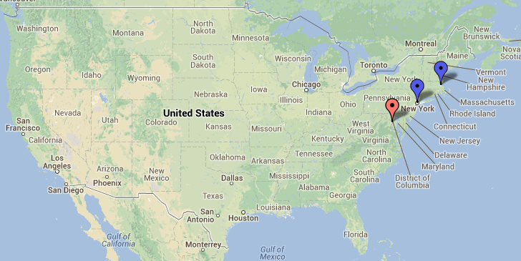
Replicating & testing the model
IMLS-funded grants to test model in New York (METRO) and Boston areas (Harvard / MIT)

Slide 5
Replicating what exactly?
Residency structure
Resident & host cohort model
Resident eligibility & application requirements
Single institution administrating program
Distributed hosts within the same metropolitan area
Core curriculum

Slide 6
Since we last met...
May 2013
1st NDSA NE meeting
Oct. 2014
2nd NDSA NE meeting

Slide 7
A lot has happened!
1st Round NDSR Boston & NYC residencies started
NDSR DC residents selected
NDSR Boston Project Manager hired
LC/IMLS announce call for hosts for 2nd round of NDSR DC
NDSR DC 1st Round
NDSR Boston/NYC 1st Round
May. 2013
1st NDSA NE meeting
NDSR Boston hosts selected
NDSR Boston residents selected
Oct. 2014
2nd NDSA NE meeting

Slide 8
In DC
NDSR DC residents selected
LC/IMLS announce call for hosts for 2nd round of NDSR DC
NDSR DC 1st Round
May. 2013
1st NDSA NE meeting
Oct. 2014
2nd NDSA NE meeting
Notes:
10 residents -> 5, 9 months -> 1 year

Slide 9
DC pilot: positive benefits
100% of the residents said the program:
Increased their knowledge and skills in digital stewardship
Strengthened their professional networks
Made them more competitive in the job market

Slide 10
DC pilot: areas to improve
Program logistics (communication, management, etc.)
Host engagement
Curriculum beyond the immersion week
Building a national program out of the regional NDSR programs

Slide 11
In Boston (and NYC)
1st Round NDSR Boston & NYC residencies started
NDSR Boston Project Manager hired
NDSR Boston/NYC 1st Round
May. 2013
1st NDSA NE meeting
NDSR Boston hosts selected
NDSR Boston residents selected
Oct. 2014
2nd NDSA NE meeting

Slide 12
Boston model refinement
Extended curriculum
Formal development plans, residency requirements, progress tracking
More host involvement
Preservation-specific focus for resident projects
Additional roles for instructors and community
Notes:
Video or online project answering “Why are you passionate about digital preservation?”
Why we wanted to replicate it in Boston:
- Need staff with real world preservation experience
- Recognized the mutual benefit to residents & hosts
- Aligns well with Harvard/MIT outreach & educational mission
- Many local/regional learning opportunities
- Strengthen regional institutional relationships

Slide 13
Timeline
5 residents in NY
5 residents in Boston
5 residents in NY
5 residents in Boston
Sept. 2014
June 2015
Sept. 2015
June 2016

Slide 14
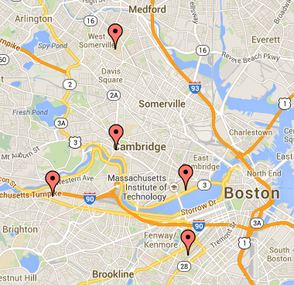
Boston hosts 2014-15
Tufts
Harvard
MIT
WGBH
Northeastern
Notes:
Role of hosts:
- Assist residents in developing a development plan with input from instructors
- Mentor resident
- Host at least one site visit for residents & hosts
- Participate in curriculum activities
- Help identify professional development and training opportunities
- Help evaluate program
Other roles:
- Instructors (Immersive week, Anytime during residency_
- Community (Participate in or organize events, Help evaluate program)

Slide 15
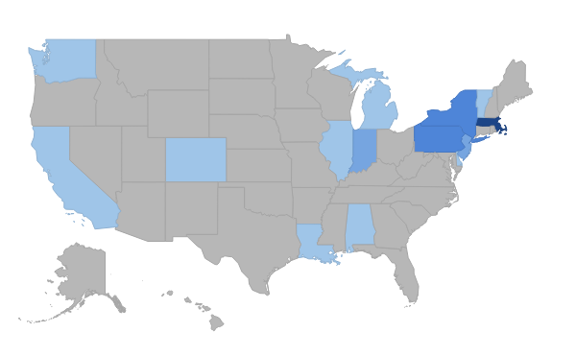
Resident applicants - state
NY (3)
PA (3)
MA (8)
IN (2)
NJ (2)

Slide 16
Boston applicants - school

Slide 17
Boston applicants - degrees

Slide 18
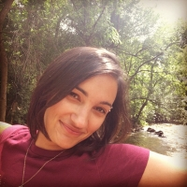
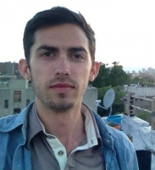
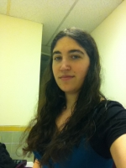
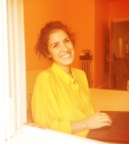
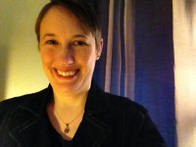
Boston Residents 2014-15
Jen LaBarbera Host: Northeastern
MLIS
Joey Heinen Host: Harvard
MA MIAP
Rebecca Fraimow Host: WGBH
MA MIAP
Tricia Patterson Host: MIT
MS LIS
Samantha DeWitt Host: Tufts
MS LIS

Slide 19
NDSR Curriculum
Nancy McGovern, MIT Libraries

Slide 20
Curriculum
Immersive week to provide a landscape view of digital stewardship
Scheduled events that build on pre-existing community events whenever possible
Group activities that extend experiences and build community
Individual residency requirements tailored to projects, skills, and interests

Slide 21
Immersion week
Launched the residencies
Morning instruction
DPOE*: Identify, Select, Store, Protect, Manage, Provide
Interactive with examples pertaining to projects
Afternoon demonstration and hands-on
Demo relevant tools for projects
Review workflow scenarios and practical examples
Discussion and review
Participation by hosts, instructors
*DPOE = Digital Preservation Outreach and Education

Slide 22
Resident development plans
Developed by the resident in consultancy with their mentor
Documents:
Project-specific topics, skills & tools to learn so that the project goals can be achieved
Professional development goals – topics & tools to advance resident’s knowledge and skills

Slide 23
Residency events
Scheduled curriculum events
In-person presentations, demonstrations, etc.
On-line activities, e.g. webinars plus discussion
Group activities
Events at host institutions
Participation in regional events
Tours, visits and networking
Collaborate on organizing events
Capstone event
Notes:
Residency requirements:
- Attend scheduled events
- Identify one event to organize and/or lead
- Categories of requirements, one or more activity per category
Category: Community
e.g. volunteer to help a professional group
Category: Skills Development
e.g. identify skills, interview person for each

Slide 24
September residency events
Optical Media, NDSA Standards & Practices Working Group Call
Launch of residents’ blog (ndsrboston2014.wordpress.com)
The Information: A History, A Theory, A Flood by James Gleick, NEASIST Program Committee
MIT Fellows event
Open house, MIT Digital Sustainability Lab
Notes:
There were probably more that I don’t know about

Slide 25
Some upcoming events
Site visits to NEDCC, JFK library
NYC & Boston Google Hangout
Jan. 2015 – Open mid-year event
Monthly events at NDSR Boston hosts
Mar. 2015: NDSR DC/Boston/NYC presentation at NEA/MARAC
May 2015: Open NDSR Boston capstone event

Slide 26
Institutional Knowledge of Research Data at Tufts University
Samantha DeWitt, Host: Tufts University

Slide 27
NDSR Boston
Samantha DeWitt
Tufts University
Tisch Library
Medford, MA
Institutional Knowledge of Research Data

Slide 28
NDSR Boston
Tufts University
10 Schools:
School of Arts and Sciences • School of Engineering • School of Medicine School of Dental Medicine • Sackler School of Graduate Biomedical Sciences
Friedman School of Nutrition Science and Policy • Cummings School of Veterinary Medicine • Fletcher School of Law and Diplomacy
College of Special Studies • Tisch College of Citizenship and Public Service
Tufts was first named a Research Category I university by the
Carnegie Foundation in 1989
Today Tufts is rated as a university with
"very high research activity"

Slide 29
NDSR Boston
Tufts University
Project Goals:
Help Tufts gain a more complete understanding of the research data produced by its faculty, research staff, post docs and graduate students.
Investigate strategies for producing metadata objects for the Fedora-based digital repository. These objects would represent Tufts-created datasets, which would be either referenced (more likely) or stored in the repository (less likely).

Slide 30
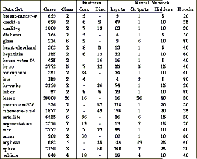
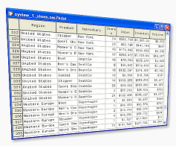
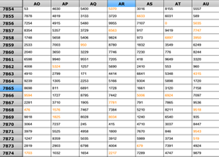
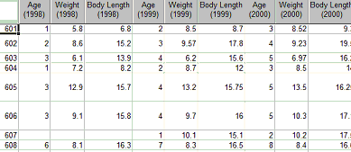
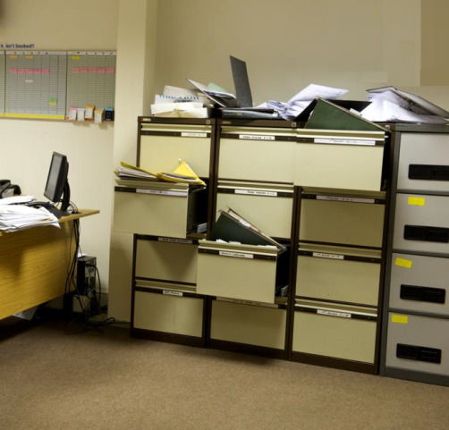
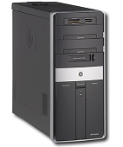
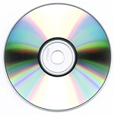
NDSR Boston
Research Data
?
Storage

Slide 31
NDSR Boston
Q:
Why is it important for Tufts to understand the kind of research data it produces and how does this project relate to the missions of the Tufts libraries?
A:
Understanding the scope of present and future datasets enables Tufts to better understand its data management and stewardship obligations.
Tisch Library Mission Statement
“…The library acts as a gateway and a contributor
to networked information in and outside of Tufts.”

Slide 32
NDSR Boston
Office of Research Administration (ORA)
Office of Proposal Development (OPD)
In providing assistance in research data management, Tufts libraries augment the work of the university’s research offices by helping to:
Assure that Tufts is in compliance with funders’ data management mandates.
Create an environment that encourages and facilitates research.

Slide 33
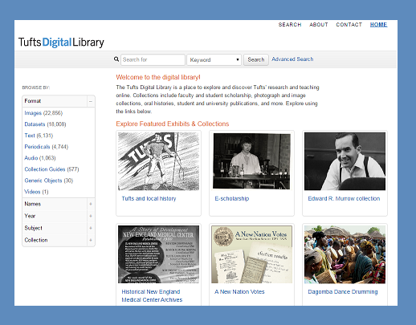
NDSR Boston
The collections of the Tufts Digital Library support teaching and research at Tufts and feature resources of enduring value, created by the community’s members.
http://dl.tufts.edu/

Slide 34
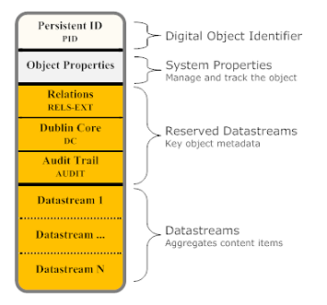
NDSR Boston
Fedora Object Model
Control Groups:
Internal XML Content
Managed Content
Externally Referenced Content
Redirect Referenced Content

Slide 35
WGBH Digital Media Preservation Project
Rebecca Fraimow, Host: WGBH

Slide 36
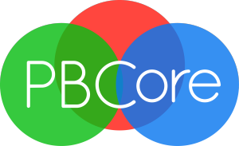
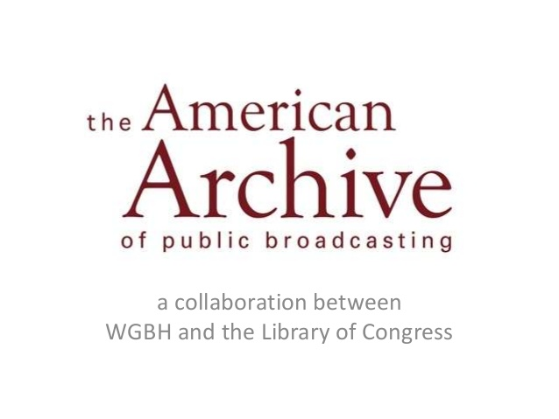
Major initiatives…

Slide 37
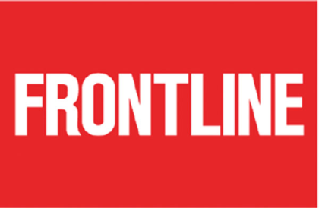
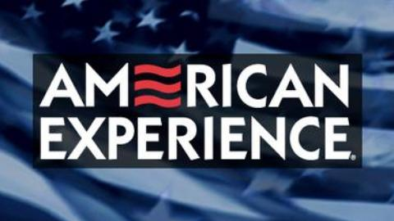
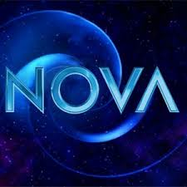
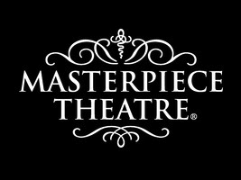
…and daily operations
Stock sales
Production assistance
Researcher assistance
Administrative metadata management
Descriptive metadata management
Rights metadata management
Ingest into DAM
LTO backup and maintenance

Slide 38
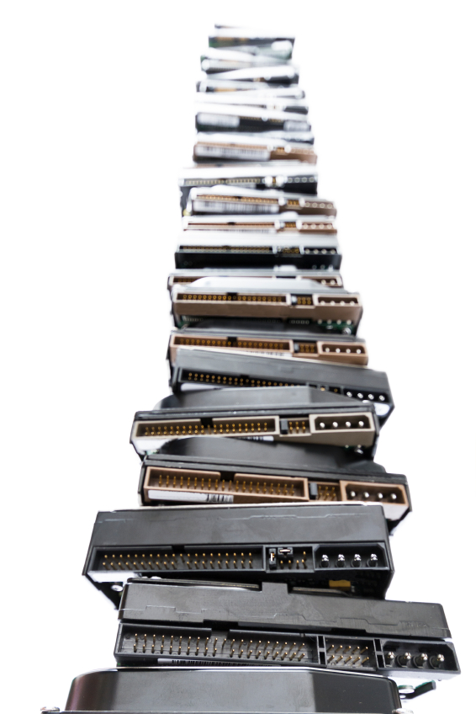
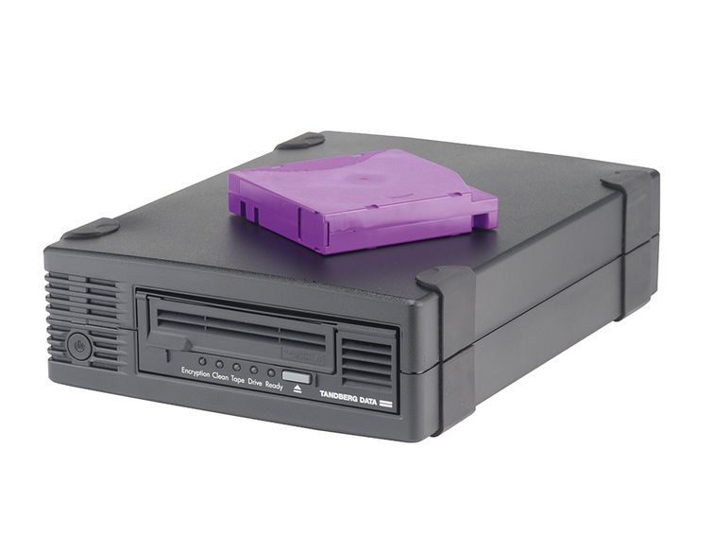
Phase One
Phase One

Slide 39
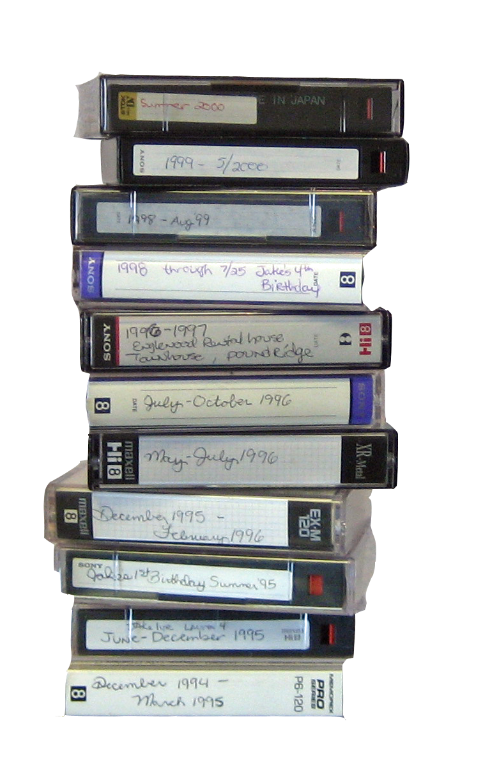
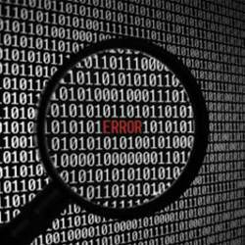
Phase One
Phase Two

Slide 40
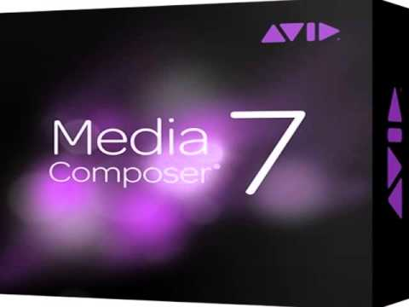
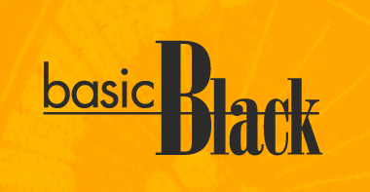
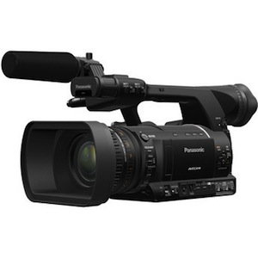
Phase One
Phase Three

Slide 41
Phase One
Phase Four
AAPB
Digital
Preservation
101

Slide 42
Rebecca Fraimow rebecca_fraimow@wgbh.org ndsrboston2014.wordpress.com @rhfraim

Slide 43
Format Migration Plans and Framework for Harvard Library
Joey Heinen, Host: Harvard Library

Slide 44
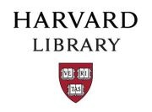
Joey Heinen
National Digital Stewardship Resident
Format Migration Plans and Framework for Harvard Library -
Kodak PhotoCD, SMIL playlists, RealAudio

Slide 45
File Formats Migration – What are the real hazards
http://liber2014.univie.ac.at/fileadmin/user_upload/DOEVL_events/Kongressfiles/2014-05-20_LIBERworkshop_emulation_en_kb.pdf

Slide 46
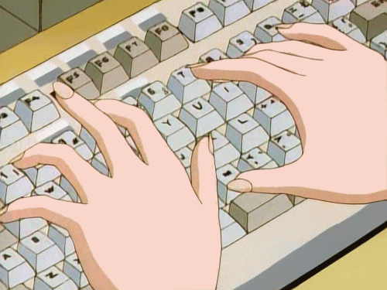
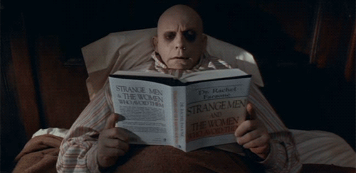
Research – A Manic Process
Compiled Bibliography, reviewed, and culled to 30+ materials
-Data Migration Projects (large data centers)
-Format-specific case studies
-Workflow design and integrated systems (some tools)
-Development of new tools
-Understanding formats

Slide 47
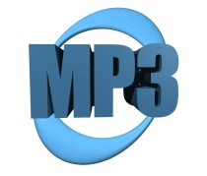
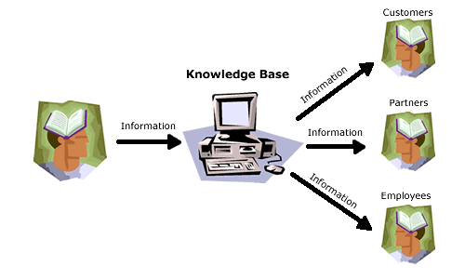
Tools vs. Experiments – A few red herrings
Examples – AONS (Automatic Obsolescence Notification System)
GREAT concept, but major pieces missing…
-No authoritative/controlled index to reference
-Lack of robustness to characterize objects and identify inherent risks
http://www.willanswer.com/kbinfo/Main.aspx?Section=KBTourStart

Slide 48
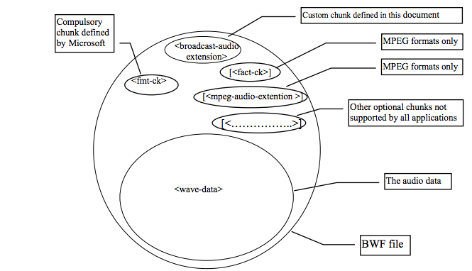
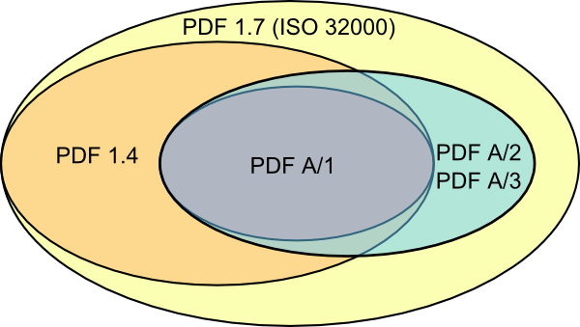
Characterization – More Missing Pieces
Even within formats there can be derivations in how that object is delivered and represented:
Formats can vary in their supported fonts, types of embedded content, how technical information is formatted and where it is located in the file, etc.
Data “chunks” in Broadcast WAVE
Attribute Overlap in PDF
http://blog.masteringworld.com/2014/04/implementation-of-isrc-codes-into-broadcast-wav-files-bwf/
http://www.openplanetsfoundation.org/blogs/2014-08-27-when-not-migrate-pdf-pdfa

Slide 49
From Source to Target – Not a One-Hop Journey!
WAVE
file
ADL
Important metadata from both!!!
SMIL
AES-60

Slide 50
Conclusions Drawn:
-Characterization is an essential step, content models should be tested to determine adequacy. All aspects of the workflow need to have a shared understanding of format complexity.
-Digital “objects” may be multivalent – external relationships are part of characterization and need to be considered in tandem with migration.
Next Steps:
-Map research/bibliography to migration workflow drafts: overall framework, format and deliverables (artifacts), context/stakeholders.
-Deep exploration of the Digital Repository Services (DRS) and how the workflow interfaces with this system.
-Into the Belly of the Beast: Intensive research on the three formats.
Joey Heinen
joseph_heinen@harvard.edu
ndsrboston2014.wordpress.com
@joey_heinen #ndsr

Slide 51
Channeling Streams of Archival Records: Northeastern University
Jen LaBarbera, Host: Northeastern University

Slide 52
Project Goals
Born digital materials: Create a workflow for ingesting born-digital content to new digital repository service (in progress)
Develop digital preservation plan for NU Libraries (beginning November/December 2014)
Legacy digital materials: Ingest obsolete legacy digital materials (e.g. floppy disks) to DRS (beginning early spring 2015)

Slide 53
Ingesting born-digital materials
Goal: Transfer all materials from current states / platforms (Omeka, external hard drive, local server, Google drive, etc) to new Fedora-based repository
Challenges:
metadata currently in Dublin Core, needs to be in MODS
managed by doctoral student who has minimal time to dedicate
agreements are scattered
new DRS is still in pre soft launch stage
others TBD

Slide 54
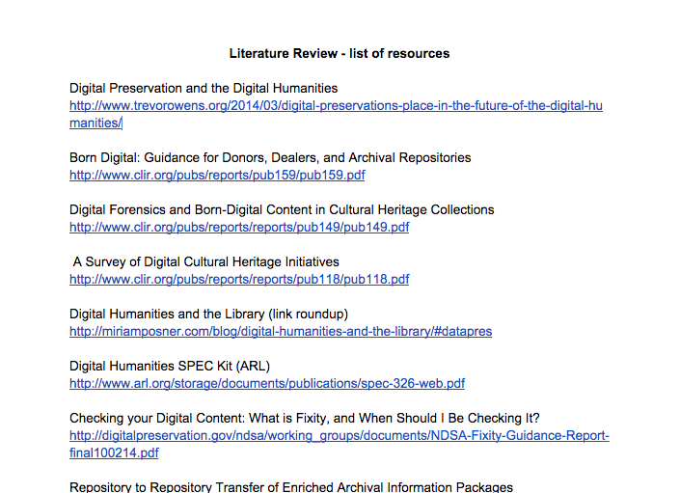
Progress - Literature Review

Slide 55
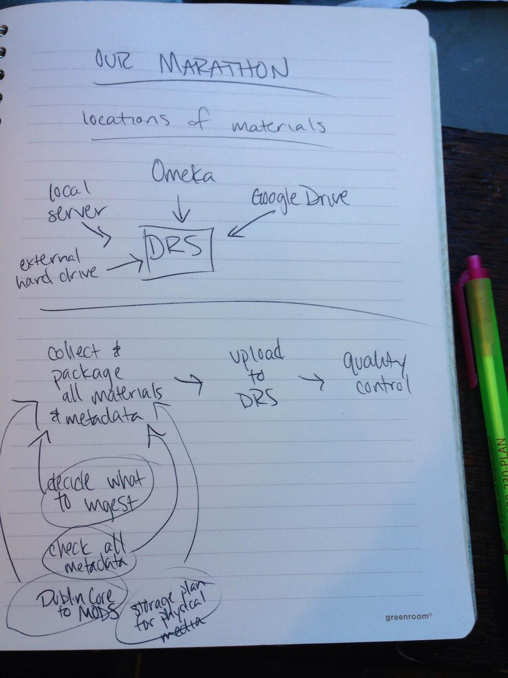
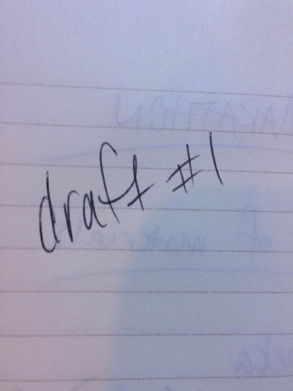
Progress - Workflow

Slide 56
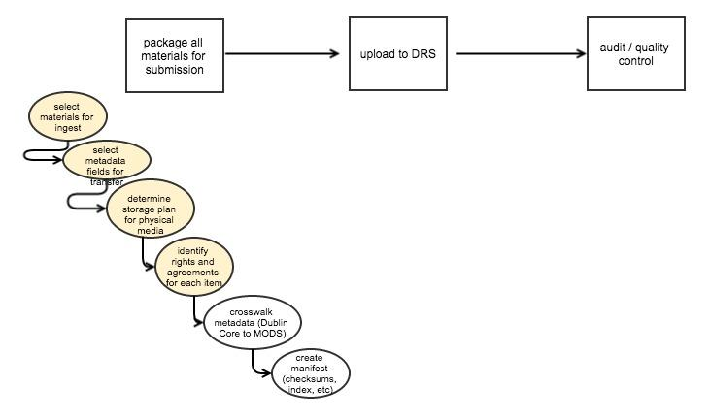
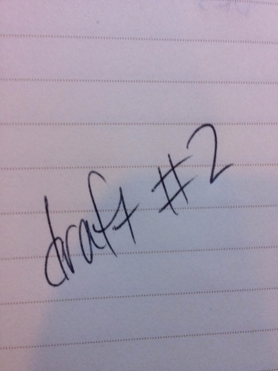
Progress - Workflow

Slide 57
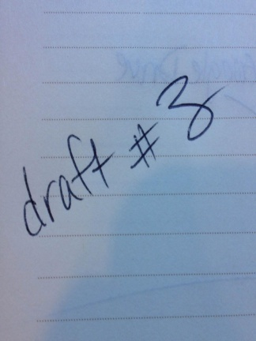
Progress - Workflow

Slide 58
Next Steps
Complete workflow for born-digital materials
Test born-digital workflow on Our Marathon, revise, test again, revise…
(in the background) DRS soft launch (November), user testing (Nov-Dec), DRS full launch (January)
Next (concurrent) project: Digital Preservation Plan

Slide 59
Making Music Last: Preservation Planning for ‘Music at MIT’ Digital Audio Content
Tricia Patterson, MIT Libraries

Slide 60
Making music last
Preservation planning for ‘music at mit’
Tricia Patterson
MIT libraries
Notes:
Hello! My name is Tricia Patterson, and I am the resident at MIT Libraries.

Slide 61
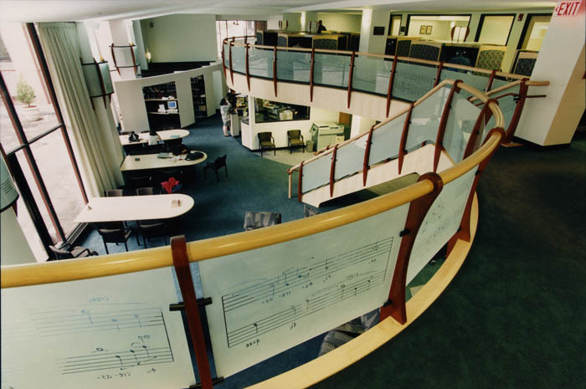
The context
Music is the 2nd most popular minor at MIT
Lewis Music Library is a subject-specific library (obviously)
Increased support for digital content management at MIT libraries
Ongoing project to inventory, digitize, preserve, and facilitate access to music content
Workflow from this can be applied to other types of digital content
Notes:
Music is actually the second most popular minor at MIT, and the music collections are specialized and popular enough that the Lewis Music Library is one of a few subject-specific library at MIT and also has a lot of faculty and alumni support. They are currently looking at digitizing and facilitating access to some of their analog audio collections of MIT music performances, which has also catalyzed a need to think about their digital preservation. So the Institute Archives and Special Collections along with the Lewis Music Library assembled a team to tackle the “Music at MIT” digital audio project in order to inventory, digitize, preserve, and facilitate access to audio content in their collections. And since audio content is also prevalent throughout MIT collections, this presents an opportunity to develop an optimal, detailed life cycle workflow, from ingest to access. So the “Making Music Last” initiative at MIT Libraries was designed to extend the work of the “Music at MIT” digital audio project.

Slide 62
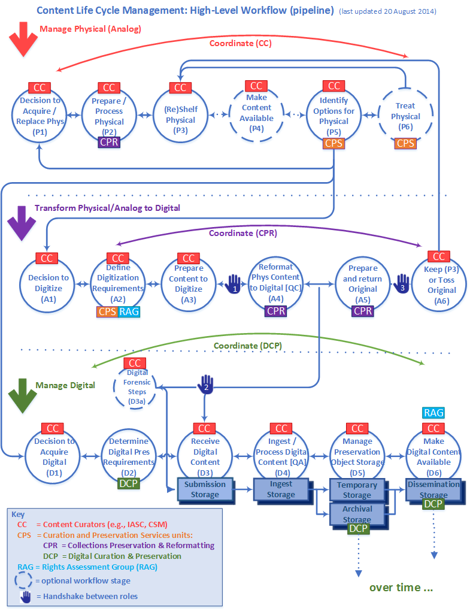
The project
Gap analysis of workflow documentation
Test and enhance the life cycle workflow
Create general digital content management workflow
Create digital audio use case
Help evaluate dissemination options for audio
Consider extensibility of access platform
Notes:
Pictured here is a high-level diagram of the current iteration of the workflow, as developed by Nancy and her team prior to my arrival. It looks pretty cool! To enhance and flesh out the workflow, I am helping to run a gap, or gap-and-fill, analysis of the current documentation. As we fill in documentation, we will also be testing the workflow, making sure it is applicable. We will be creating a general workflow and calling out use cases for specific content types when they differ, such as audio content, GIS, visual collections, &c. One of the music library’s priorities is to start making some of their special collections audio content accessible as well, so we will be evaluating Avalon Media System as a potential dissemination platform. We would also like to figure out how any of the legwork done for audio content can be extended towards audiovisual content.
As a residency, definable outcomes are outlined for both MIT and myself, as an emerging professional. Some of the deliverables for the project include a completed gap analysis of the workflow, enhanced general workflow documentation and an audio use case, and an access environment for digital audio content. Through this project and the outside work I do, I will gain skills in managing digital content over the full lifecycle, as well as learning practical software tools such as BitCurator, Archivematica, and Avalon.

Slide 63
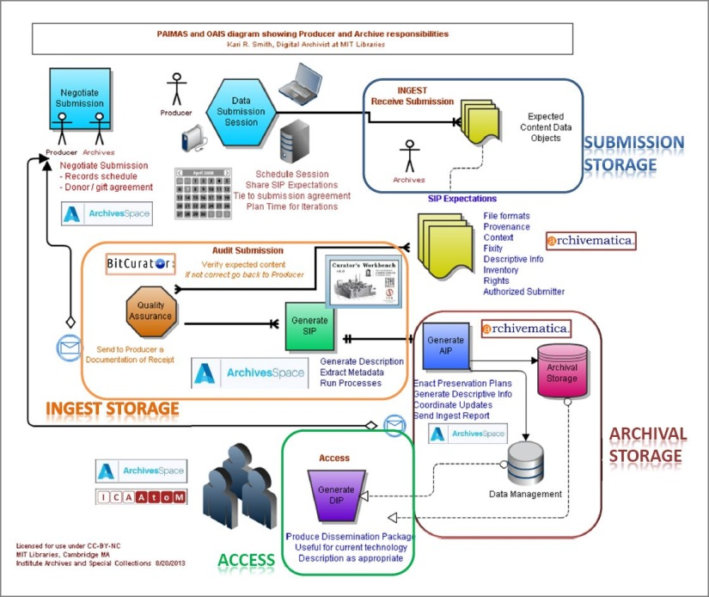
What is a workflow?
Notes:
This in-depth workflow documentation is really underlining the significance of what good workflow practices are. Something that Nancy and Kari Smith, MIT’s digital archivist, have spoken about is going into institutions and people saying, “Yah, we have a workflow,” but upon asking to see it, the response is, “Well, we know how the work flows, procedures, &c.” So some institutions may be lacking a documented high or low-level workflow. Others institutions may acquire new tools before they know where it is definably needed in their workflow. So you may end up putting a lot of time and energy into a tool before laying the groundwork and realizing it doesn’t serve your needs. What we are working towards is really building that foundational, detailed workflow documentation and then fitting in the tools necessary – after the planning is mapped out. And this last image is one that Kari Smith put together, which is an amalgamation of the organizational and technological contexts.

Slide 64
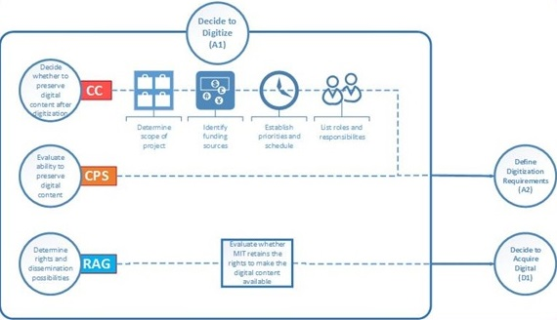
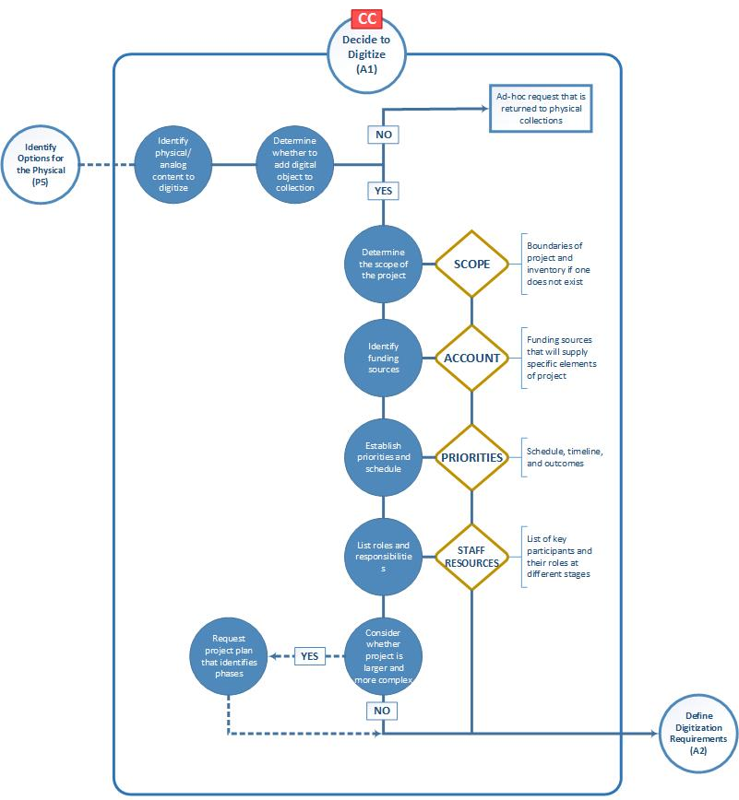
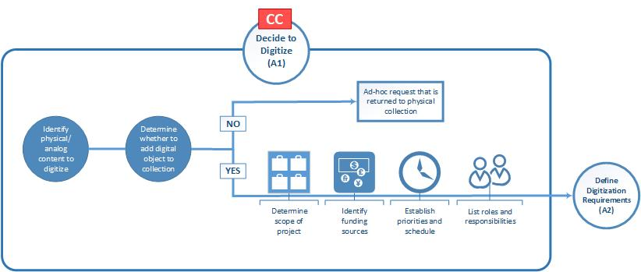
THE WORK!
1
3
2
Notes:
Here is an example of some different versions of just the first stage of the middle area of the workflow. You can see the various permutations it has taken on as the documentation changes or my understanding of the work changes: which roles are called out, what tools are needed, which inputs and outputs from other stages need to be documented. This kind of detailed documentation may seem like a no-brainer to have, but it’s not something a lot of people have really taken the time to do yet – because it really does take time. Once you have it, though, it contributes to the institutional knowledge instead of relegating important information to one stakeholder. Clarifying roles between agents throughout the process is illuminating and can improve morale and communication. Finally, mapping out your work process can enhance your understanding of which tools you actually need to integrate in order to get from point A to point B instead of throwing money at new software and hardwares that don’t actually end up serving your needs. A tested workflow also just guarantees reliability and repeatabe quality in your processes.

Slide 65
MORE OF The work!
Avalon evaluation
Digital audio music project (DAMP)
DAMP workflow subgroup
Digital audio scan
Digital content management workflow/gap analysis
Workflow/gap analysis literature review
Notes:
These are some of the other projects I have actually started working on since I arrived at MIT in mid-September. I am doing a workflow literature review to get an idea of where we are in the context of workflow conversations and see if there are useful things we can borrow from other fields. I am on their Avalon Media System evaluation team, and Nancy and I are looking at how TRAC-compliant it is in terms of access. I have been building on their digital audio scan which surveys what’s going on in the field. And I have been drafting general workflow documentation for the different stages. I will also be utilizing MIT’s new Digital Sustainability Lab to test the developing workflow.

Slide 66
The end
Notes:
This has been a fitting residency project for me so far because I was particularly interested in gaining a full lifecycle perspective on digital preservation. Helping build this workflow and collaborating with colleagues that are representative of the different stages is already giving me a much deeper understanding of the OAIS model and where particular tools and systems are appropriate. Also, outside of my work at MIT, as others here have discussed, the residents organize and participate in other professional development opportunities. I am contributing to our blog, arranging a tour of another eminent institution, collaborating on other group project ideas, developing a host event with Nancy, participating in conferences when relevant, and creating a final deliverable that can be useful to an external audience. So we really are moving right along, and it is shaping up to be a successful first run of the Boston-branch of the program. Thank you!

Slide 67
Thank You!
Questions?

