Slide 1
NDSA Update: TRAC Review Project and DPOE
Nancy Y McGovern, MIT Libraries
1st NDSR-NE on May 10, 2013

Slide 2
NDSA Standards: Self-assessment and Audit

Slide 3
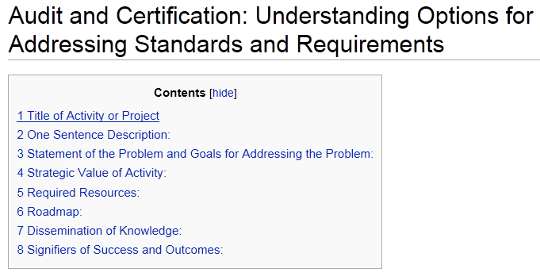
NDSA Standards Project

Slide 4
Project Activities
Community context: consolidate the documentation of the development of audit and certification for digital preservation to share with the community then continue to share results of monitoring key developments and trends in audit and certification to raise awareness and build understanding
Implementation examples: capture examples of addressing current requirements for audit and certification to determine commonalities, share lessons learned, and contribute to shared practice
Review options: identify current repository audit options that organizations might consider (e.g., peer review audit, audit by service), document examples of the application of audit options with considerations for use in various contexts (e.g., type and size of organizations, desired outcomes), and monitor emerging options to maintain options list

Slide 5
Related: Peer Review Audits
Frame for ongoing TRAC review
Version 1.0 at ICPSR – 2007 TRAC document
Version 2.0 at MIT Libraries – ISO 16363
Mapping
Numbering: A, B, C = 3, 4, 5, sort of…
Sub (and sub-sub) elements
Re-sequencing
Artefactual hosting two instances for test audits

Slide 6
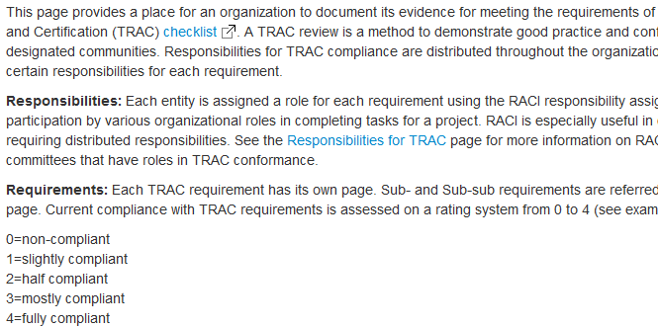
Trusted Repositories Audit and Certification

Slide 7
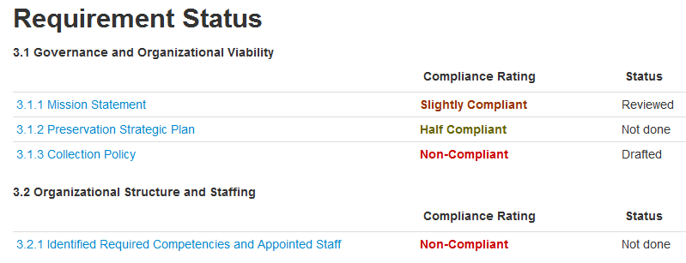

Slide 8
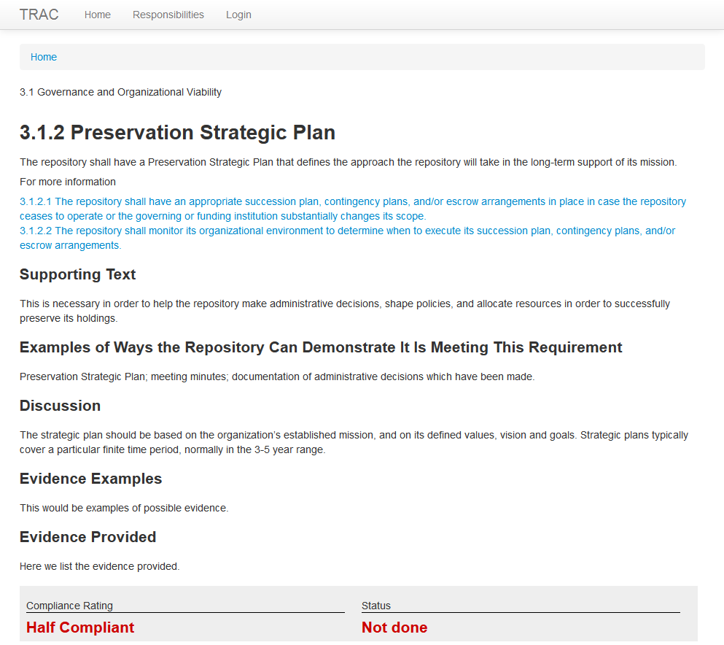

Slide 9
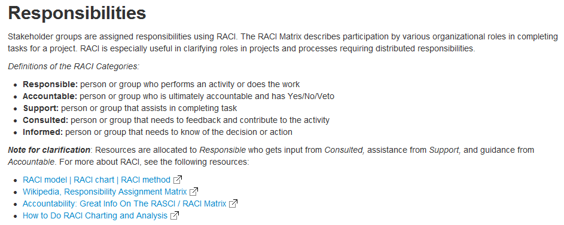

Slide 10
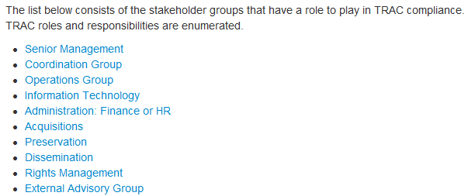

Slide 11
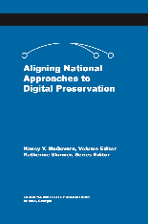
ANADP
Aligning National Approaches to Digital Preservation
Envisioning an International Community of Practice
National examples (Estonia, USA, Sweden)
Alignment aspects:
Legal
Organizational
Standards
Technical
Resources
Education
Alignment Opportunities (with Cliff Lynch)
ANADP released August 2012
http://www.educopia.org/publications

Slide 12
NDSR and DPOE

Slide 13
DPOE Baseline Modules
Identify - what digital content do you have?
Select - what portion of that content will be preserved?
Store - what issues are there for long term storage?
Protect - what steps are needed to protect your digital content?
Manage - what provisions are needed for long-term management?
Provide - what considerations are there for long-term access?
DPOE Baseline Modules: Intro, version 2.0, Nov 2011
Notes:
Note to trainers: You might re-label this slide “Topics” or “Management Stages” or something to convey the range of content covered.
You should begin any workshop with a version of this Intro Module and this slide is the time to run through the six modules, whether you are presenting all six or not. If you are presenting as subset of the modules, you might highlight the ones you will focus on, but show the whole list so the context is clear.

Slide 14
Managing Content Over Time
manage
protect
store
identify
provide
select
Notes:
Note to trainers:
Identify and Select are in the center – repeat over time: identify new/additional content then select the portion to preserve
Store the selected content
Protect what is stored
Manage it over time (preserve it) – including policies/rules for identifying, selecting, storing, protecting and providing content
Providing preserved content over time (long-term access) relies upon good management over time

